Slide 1


Slide 2
Engineering Excellence – J1
Hadoop Cluster Setup
01 Review meeting : 06/03/2016
SPRINT 2 (May 30– June 3)

Slide 3
Last Week’s Action Items
Stories should be groomed by every team member. Done
Stories should have proper sub-tasks & detailed description.
Make sure all the team members should attend weekly calls & DSM.
Sprint planning sheet should be updated by every individual.
Make sure Demo PPT should be shared before weekly call describing last week action item. - Done
Retrospective meetings will be scheduled on first or second day of next sprint. - Done

Slide 4
Last Week’s Action Items
Make sure to send retrospective - Done
Correct the burn down chart (Sync with Sadique for correct burn down sheet) - Done
Breakdown: We were not able to join bridge on time (tried with couple of bridge but unable to connect).

Slide 5
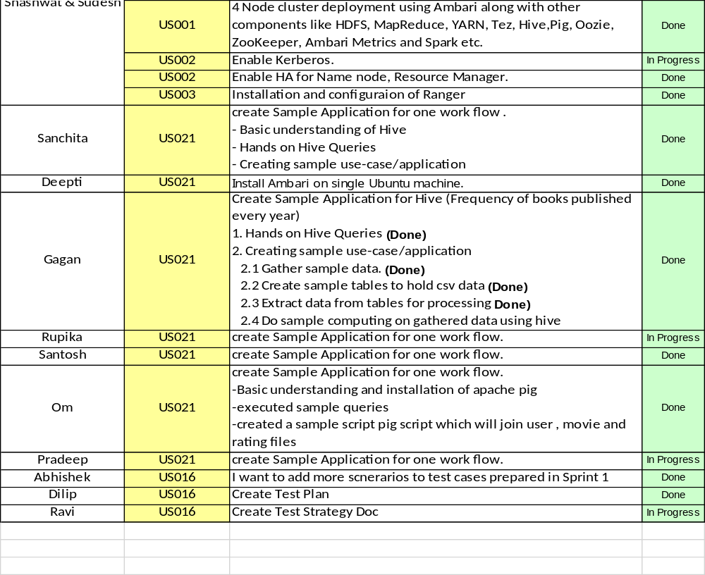
Team Status (Sprint 2)

Slide 6
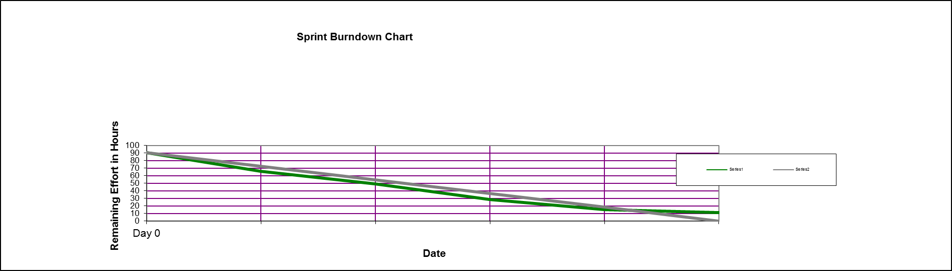
Burn down chart on – 06/03/2016

Slide 7
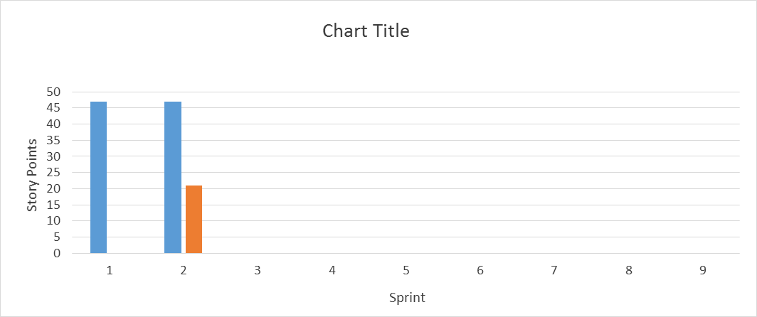
Velocity Trend on– 06/03/2016

Slide 8
Thanks

